Slide 1
AI101
Lecture 1: What is AI

Slide 2
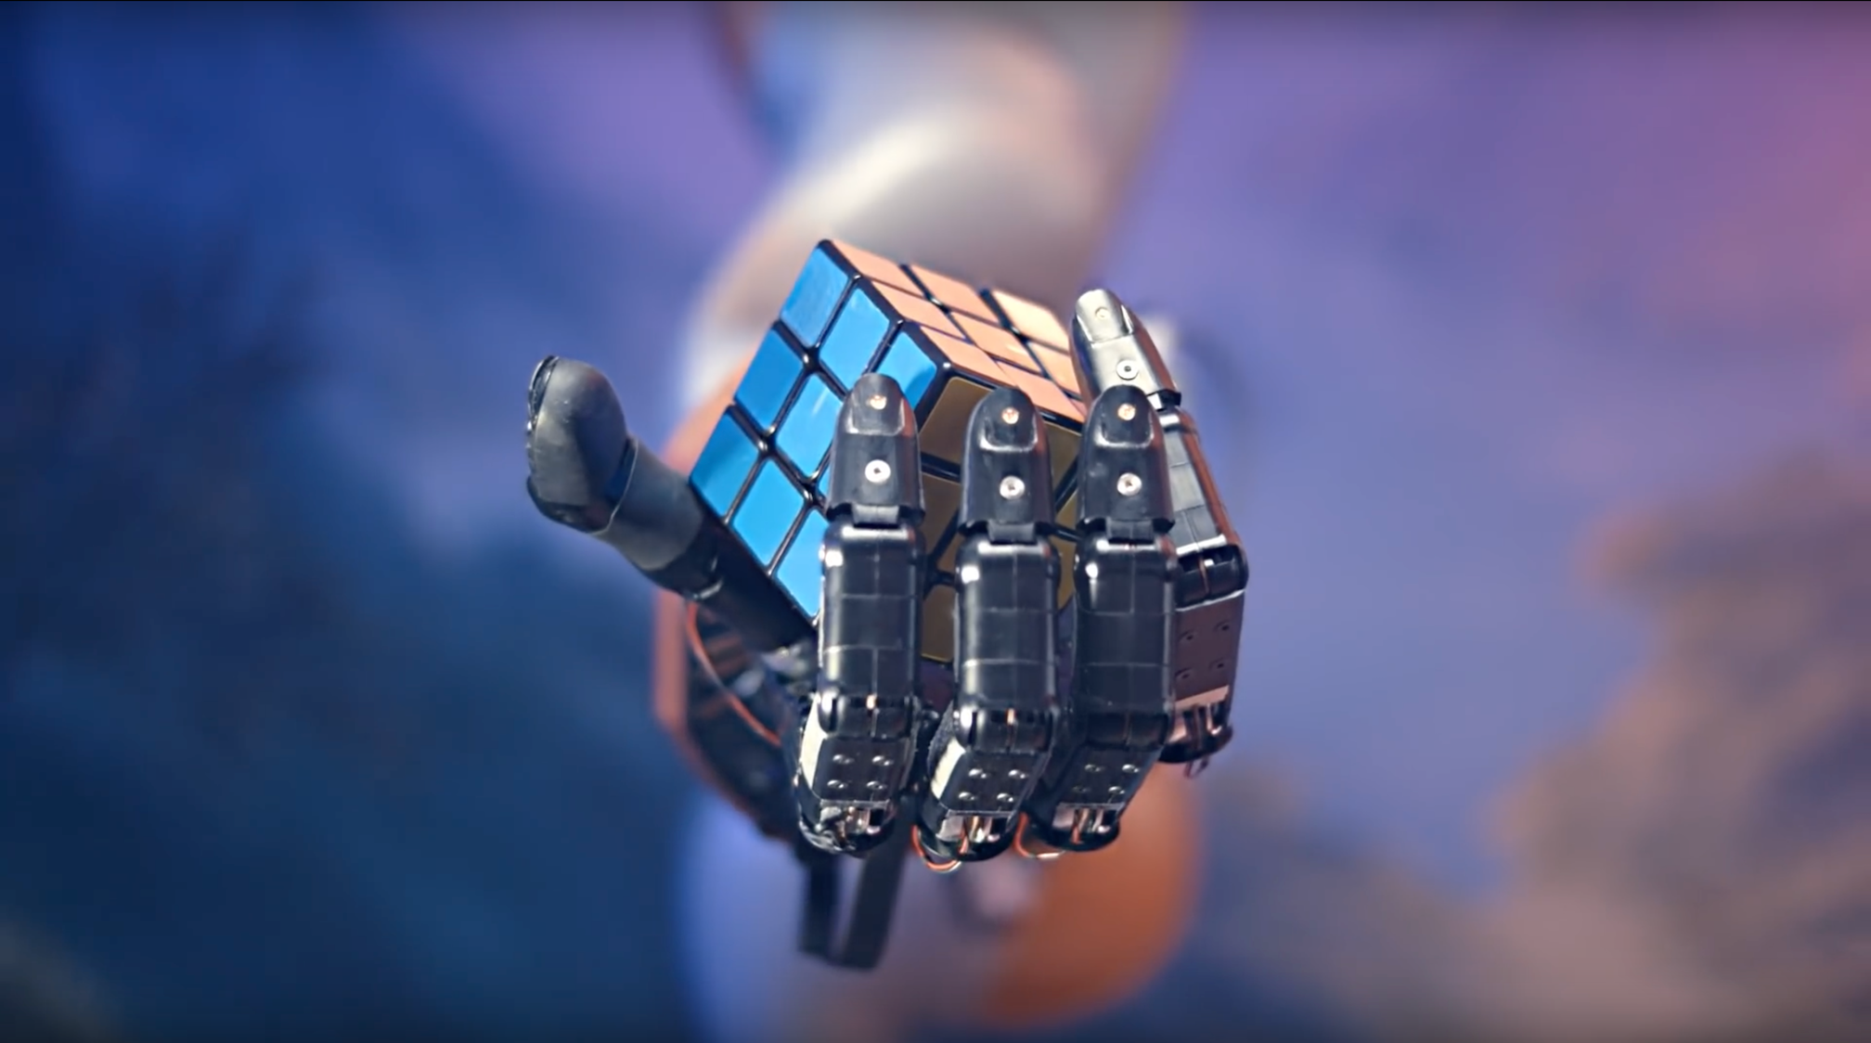
What is, and what isn‘t AI?
https://www.youtube.com/watch?v=x4O8pojMF0w

Slide 3
What is, and what isn‘t AI?
Not an easy question to answer!
Reasons:
There is no official definition
Science Fiction Influence
Easy tasks can become very hard
Hard tasks are mastered on a non-human level
The public perception of AI is nebulous
But lets try to define AI for us…

Slide 4
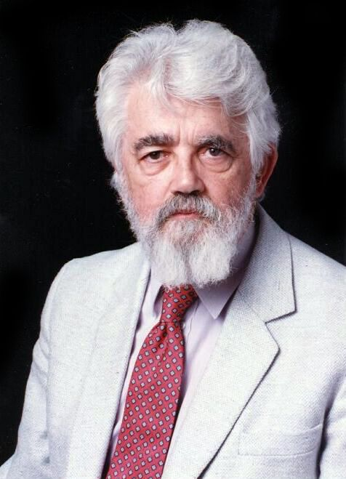
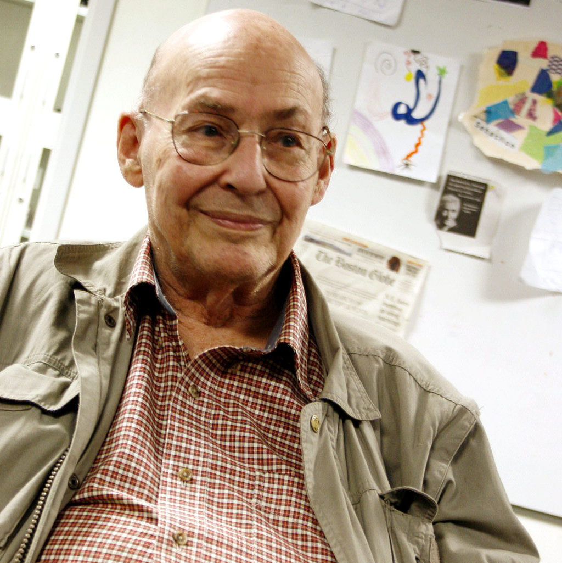
What is, and what isn‘t AI?
The science and engineering of making intelligent machines, especially intelligent computer programs.
It is related to the similar task of using computers to understand human intelligence, but AI does not have to confine itself to methods that are biologically observable.
John McCarthy, Turing Award 1971
The science of making machines do things that would require intelligence if done by men.
Marvin Minsky, Turing Award 1969

Slide 5
What is, and what isn‘t AI?
The science and engineering of making intelligent machines, especially intelligent computer programs. It is related to the similar task of using computers to understand human intelligence, but AI does not have to confine itself to methods that are biologically observable.
John McCarthy, Turing Award 1971
The science of making machines do things that would require intelligence if done by men.
Marvin Minsky, Turing Award 1969

Slide 6

What is Intelligence

Slide 7
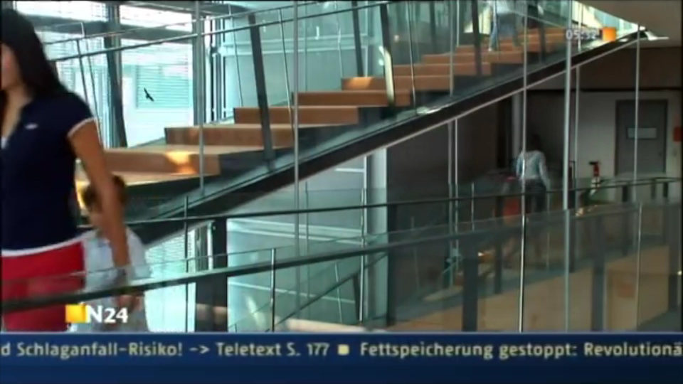
What is Intelligence

Slide 8
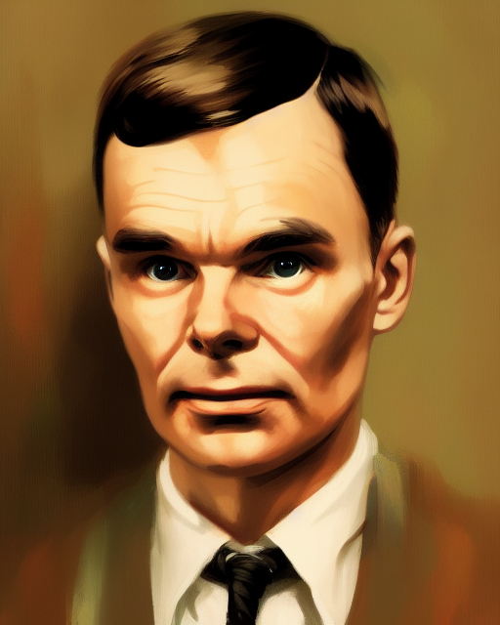
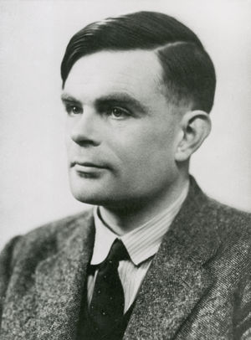
What is Intelligence
Turing Test
Question: When does a system behave intelligently?
Assumtion: An entity is intelligent if it cannot be distinguished from another intelligent entity by observing its behavior.
Test: Human interrogator interacts with two players, A and B (one of them is a computer) blind.
If the interrogator cannot determine which player, A or B, is a computer and which is a human, the computer is said to pass the test.

Slide 9
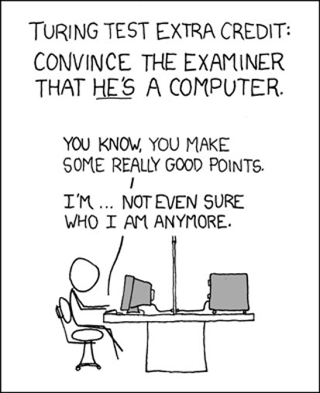
What is Intelligence
Turing Test
Test still relevant now, yet might be the wrong question.
Requires the collaboration of major components of AI: knowledge, reasoning, language understanding, learning, . . .
But hard/not reproducible and constructive or amenable to mathematical analysis.
Followup Question: Does being human-like mean you are intelligent?

Slide 10
What is Intelligence
The Chinese Room Argument
Question: Is intelligence the same as intelligent behavior?
Assumption: Even if a machine behaves in an intelligent manner, it does not have to be intelligent at all
Test:
A person who doesn’t know Chinese is locked in a room. Outside the room is another person who can slip notes written in Chinese inside the room but cannot interact with the person in the room else.
The person inside the room has detailed instructions how to answer each question without translating it or understanding it at all.
Follow-up Question: Is the person in the room intelligent? Is a self-driving car intelligent?

Slide 11
What is Intelligence
Do we need to know what an intelligent system is?
The question of how an intelligent being is defined, is a long and difficult one, but...
”unlikely to have any more effect on the practice of AI research than philosophy of science generally has on the practice of science.”
John McCarthy
Is this true? What do you think?

Slide 12
Characteristics of AI
One AI to rule them all?
General vs Narrow AI
A general AI or strong AI is defined to so that it can handle any intellectual task, while a narrow or weak one is specified to deal with a one concrete or a set of specified tasks. This is the same distinction between being intelligent and acting intelligent. While strong AI is generally a goal in research, currently we are using primarily narrow AI.

Slide 13
Characteristics of AI
An AI should be…
Adaptability
The ability to improve performance by learning from experience
Autonomous
The ability to perform tasks in environments without constant guidance by a
user/expert.

Slide 14
Characteristics of AI
Rationality
Law of Thoughts
Beginning of reasoning and the question of what ‘correct’ argument and thought processes are.​
Rational Behavior
The question of “doing the right thing”.
In systems that act rationally, the “right thing” is that what is expected to maximize the achievement given the available information.

Slide 15
So what is AI?
Different definitions due to different criteria Two dimensions:
Thought processes/reasoning vs. behavior/action
Success according to human standards vs. success according to an ideal concept of intelligence (rationality)
 | Human | Rationality
Think | Systems that think like humans | Systems that think rationally
Act | Systems that act like humans | Systems that act rationally

Slide 16
Characteristics of AI
Rationality
Rational behavior has two advantages over the law of thoughts
It is more general (in many situations, a provably correct action does not exist)
It is more amenable (rationality can be defined and optimized)
But rationality is rarely a very good model of reality.

Slide 17
Cognitive Science
Systems that think like humans
How do humans think? Theory is based on scientific theories of internal brain activities (cognitive model):
Predicting and testing human behavior
Identification from neurological data
Cognitive Science brings together computational models from AI and experimental techniques from psychology to construct precise and testable theories of the mind. Cognitive Science is often viewed distinct from AI but this is wrong. As at TU Darmstadt, both are twin disciplines!
Cognitive Neuroscience: How does the brain work at the neuronal level?

Slide 18
Foundations of AI
Different fields have contributed to AI and build the foundation of modern AI:
Philosophy: Logic, reasoning, mind as a physical system, foundations of learning, language and rationality.
Mathematics: Formal representation and proof algorithms, computation, (un)decidability, (in)tractability, probability.
Psychology: adaptation, phenomena of perception and motor control.
Economics: formal theory of rational decisions, game theory.
Linguistics: knowledge representation, grammar.
Neuroscience: physical substrate for mental activities.
Control theory: homeostatic systems, stability, optimal agent design.

Slide 19
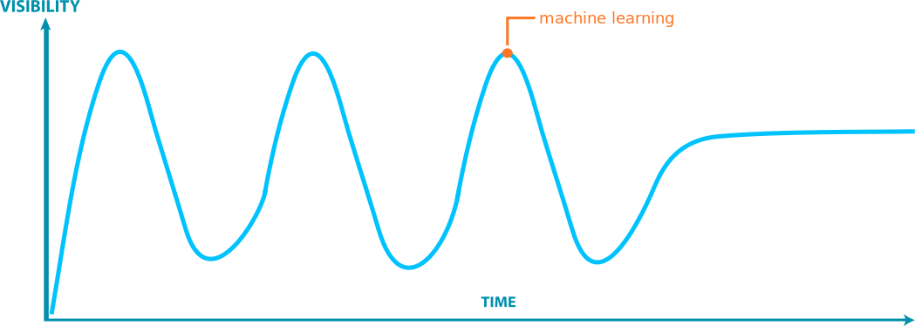
Foundations of AI History of AI in a nutshell
expert systems
neural networks
?
1956

Slide 20
Related Fields and Taxonomy of AI Taxonomie of AI
Artificial Intelligence​
Machine Learning
Deep Learning

Slide 21
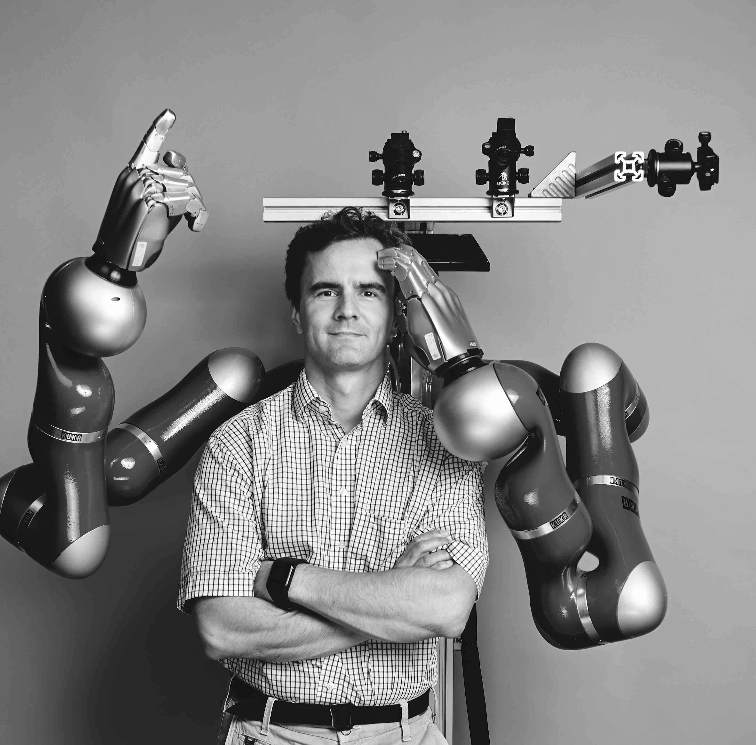


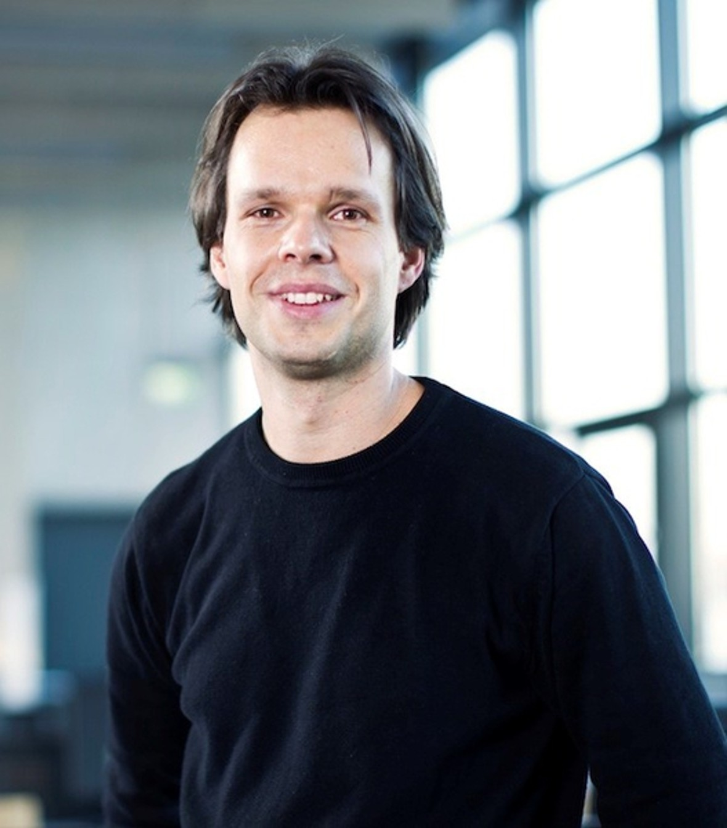


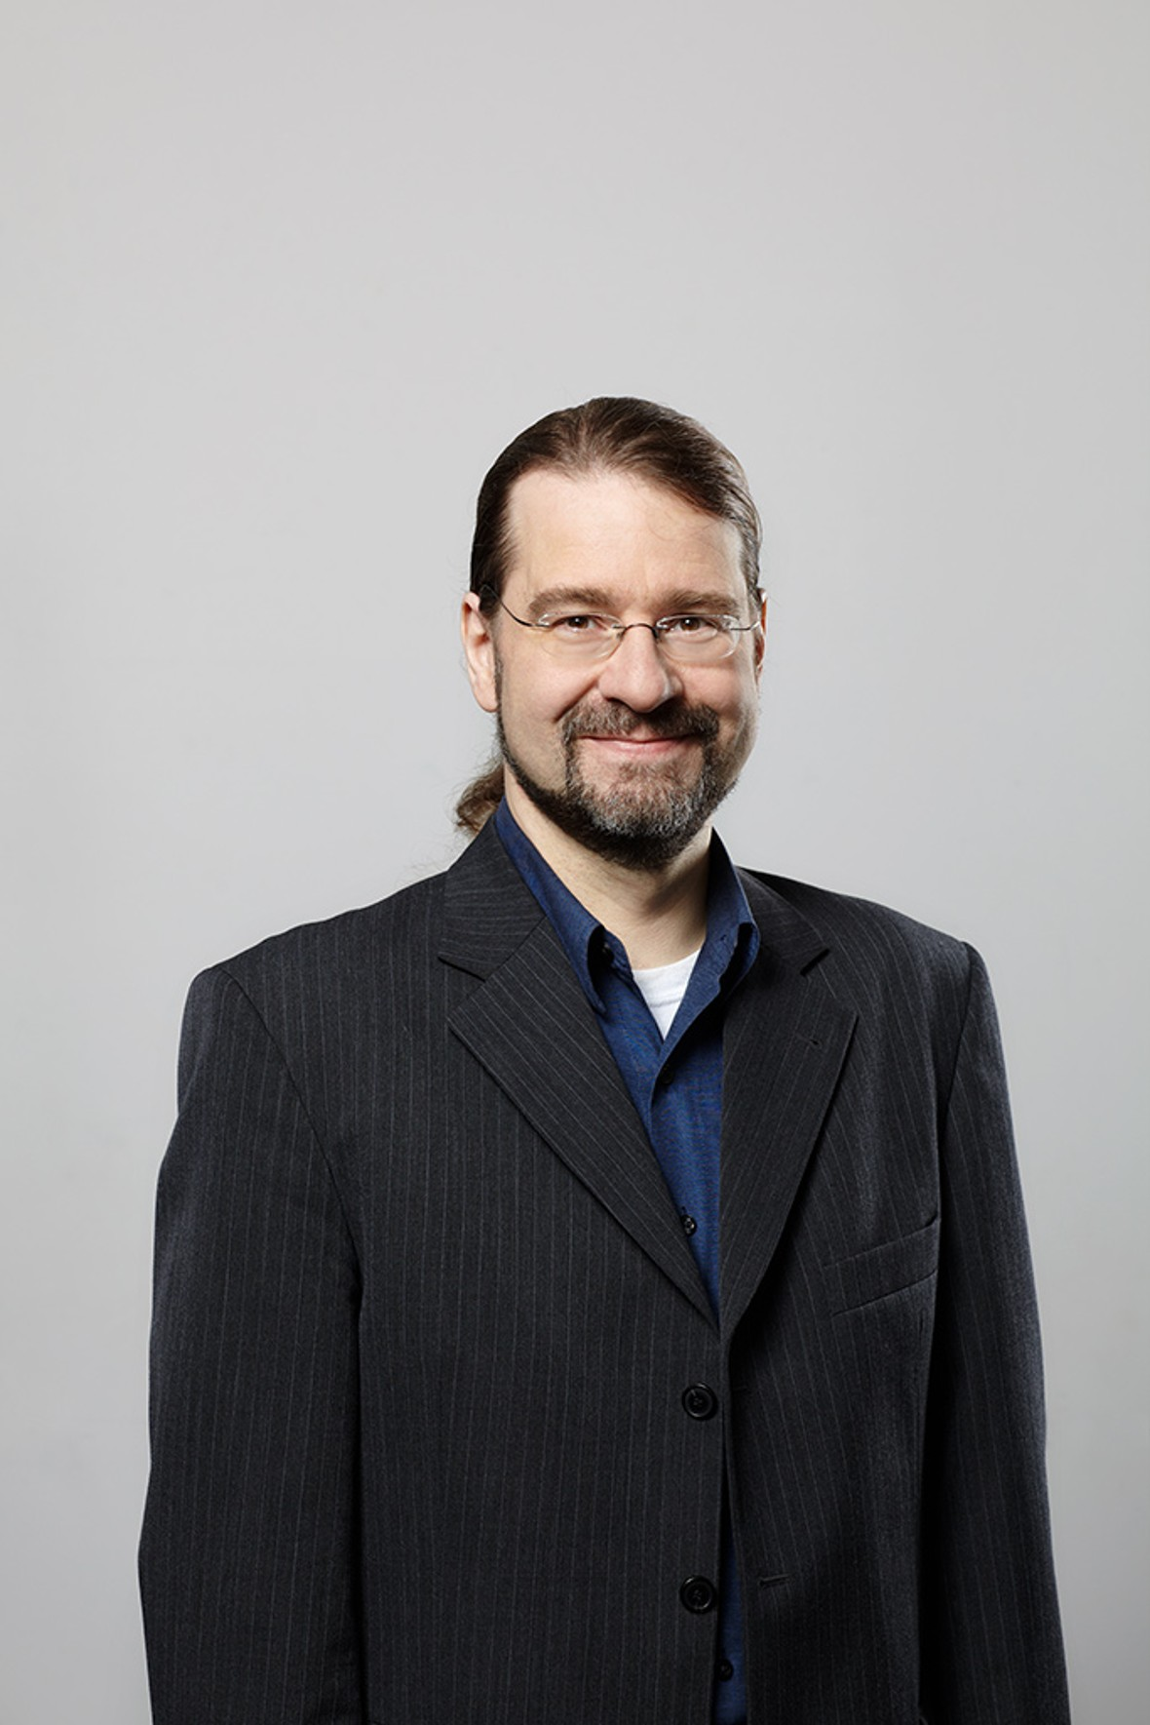






Related Fields and Taxonomy of AI Subdisciplines of AI
From top left to bottom right: Prof. Peters, Prof. Von Stryk, Prof. Chalvatzaki, Prof. Binnig, Prof. Istvan, Prof. Mezini, Prof. Koch, Prof. Kersting, Prof. Roth, Prof. Fellner, Prof. Gurevych, Prof. Rothkopf, Prof. Jäkel

Slide 22
Related Fields and Taxonomy of AI Subdisciplines of AI
Machine Learning (Peters, Roth, Kersting,...)
Deep Learning (Roth, Kersting,...)
Search and Optimization (Weihe,...)
Robotics (Peters, von Stryk, Chalvatzaki...)
Natural Language Processing (Gurevych,...)
Computer Vision (Roth, Fellner, Kuijper,...)
Cognitive Science (Rothkopf, Jäkel, Kersting, Walles,...)
AI Systems (Binnig, Istvan, Koch, Mezini,...)
Data Science (Binnig, Istvan,…)
...

Slide 23
Applied AI in Modern Fields
Autonomous Planning and Scheduling
Games (Planning, Reasoning, Understanding, …)
Natural Language Processing (Text Generation, Understanding, Translation, Speech Recognition, …)
Robotics (Autonomous driving, …)
Scientific Discovery (AI found new quasars, proved theorems,…)
Computer Vision (Autonomous vehicles, Classification, Segmentation,…)
…

Slide 24
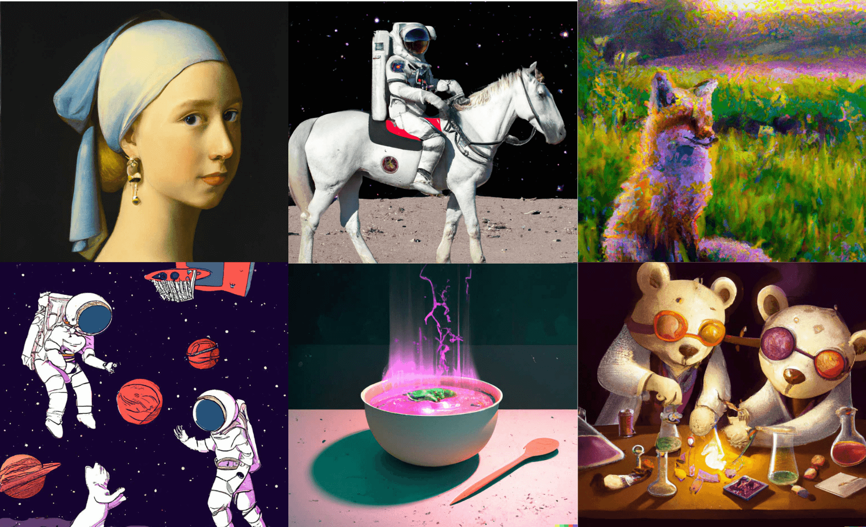
What AI can and cannot do AI as an Artist: Dall∙E 2
https://www.youtube.com/watch?v=qTgPSKKjfVg

Slide 25

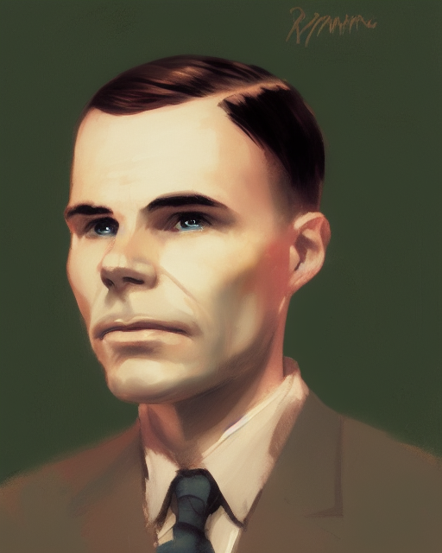
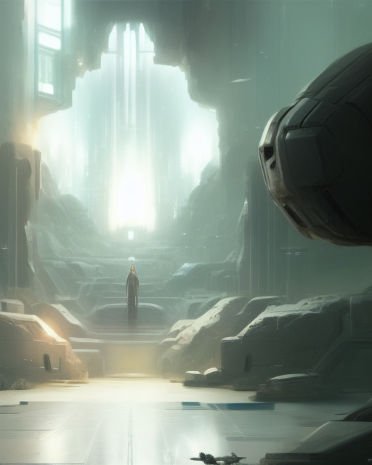
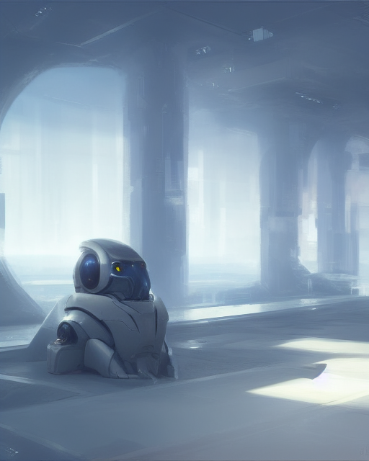
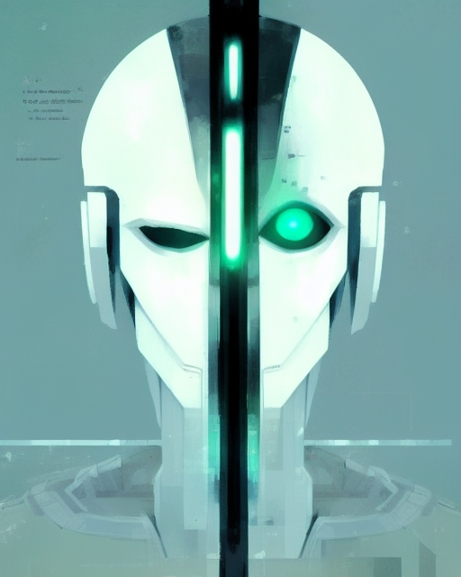

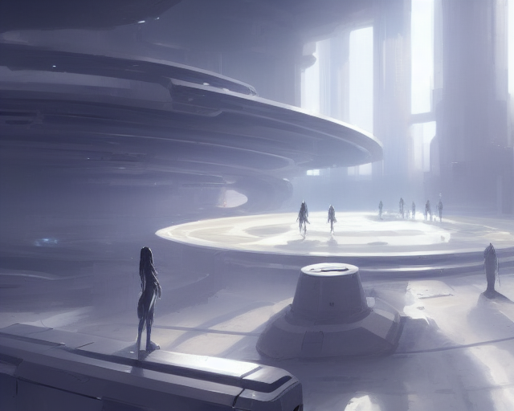
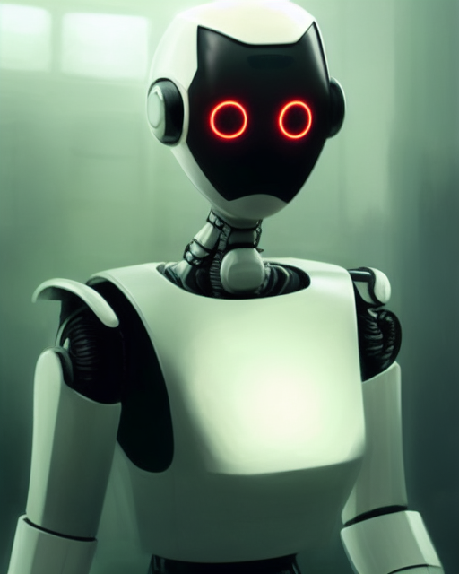
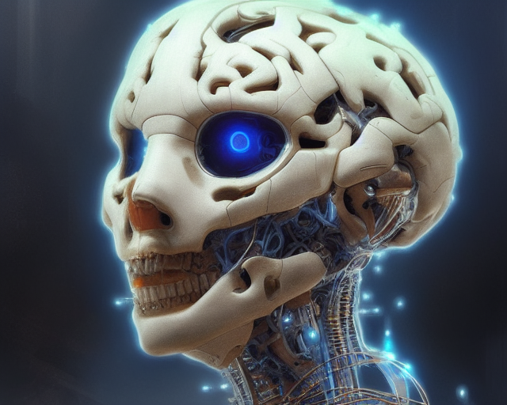
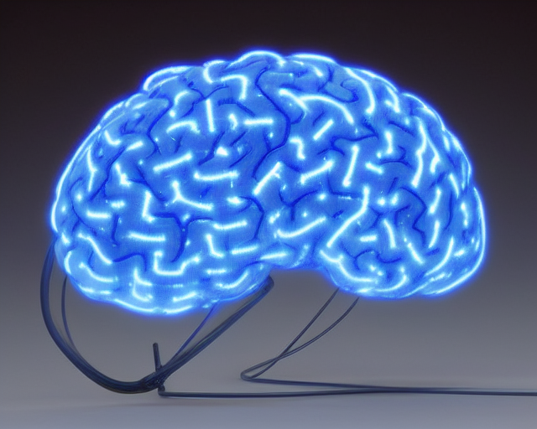
What AI can and cannot do AI as an Artist: Stable Diffusion
Stable Diffusion generates images to the topics of this lecture

Slide 26
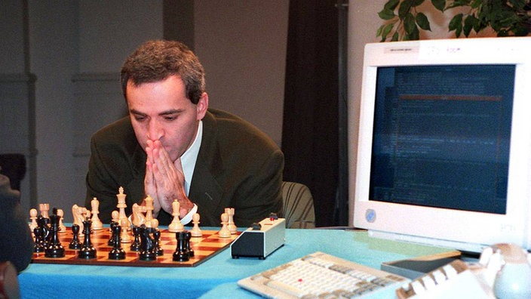
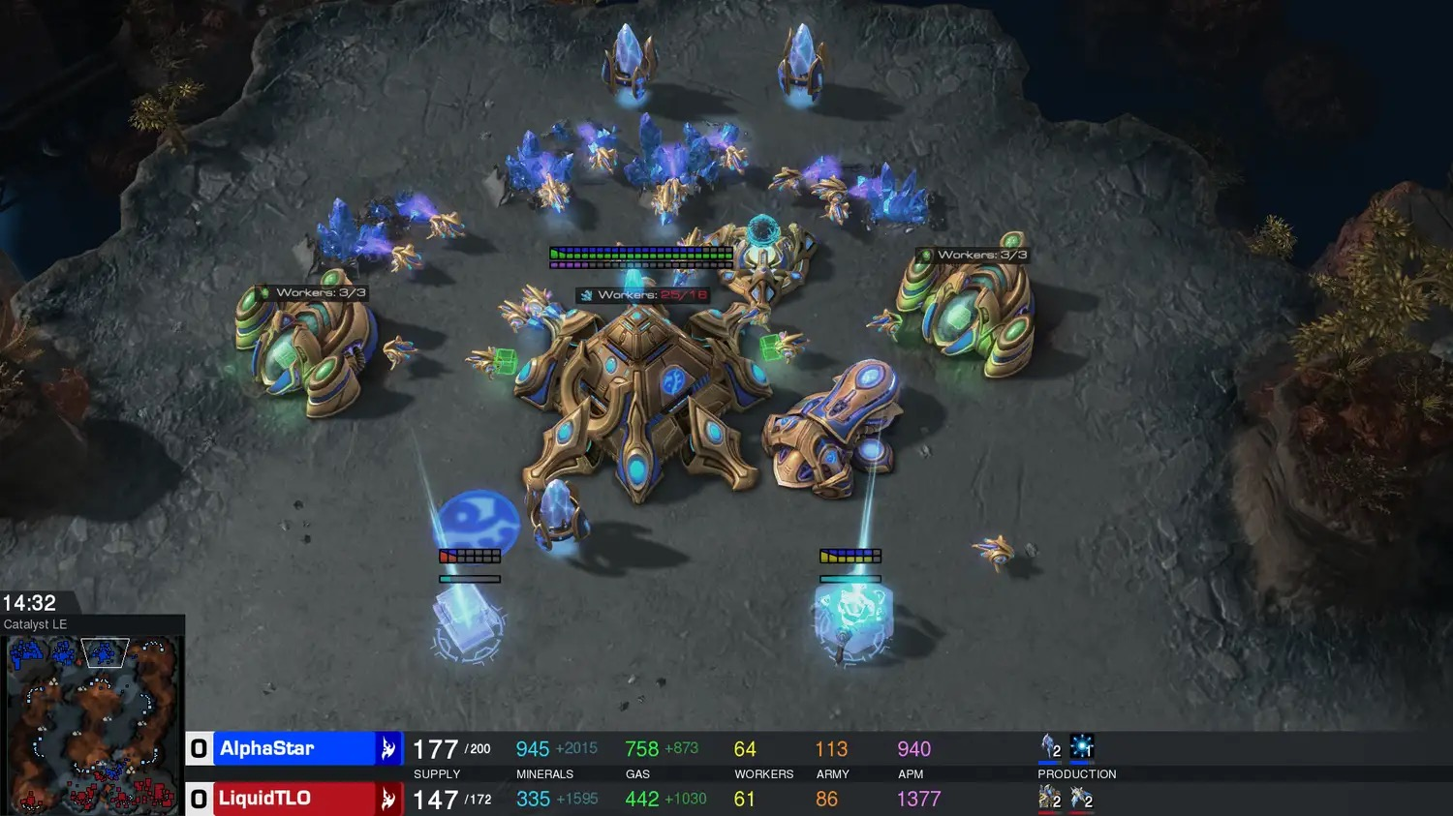
What AI can and cannot do AI playing Games
From top left to bottom right: AI plays chess (DeepBlue), AI plays Go (AlphaGo), AI plays Crazyhouse Chess (CrazyAra), AI plays Starcraft 2 (AlphaStar)

Slide 27

What AI can and cannot do AI as an Assistant

Slide 28
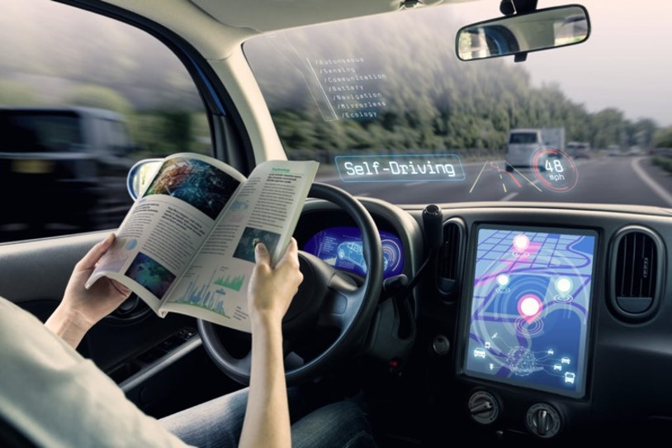
What AI can and cannot do AI drives cars
https://www.youtube.com/watch?v=XAQeL8eflT0

Slide 29

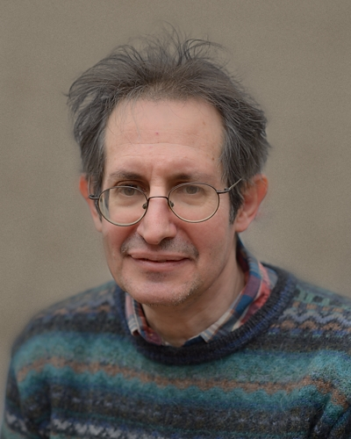
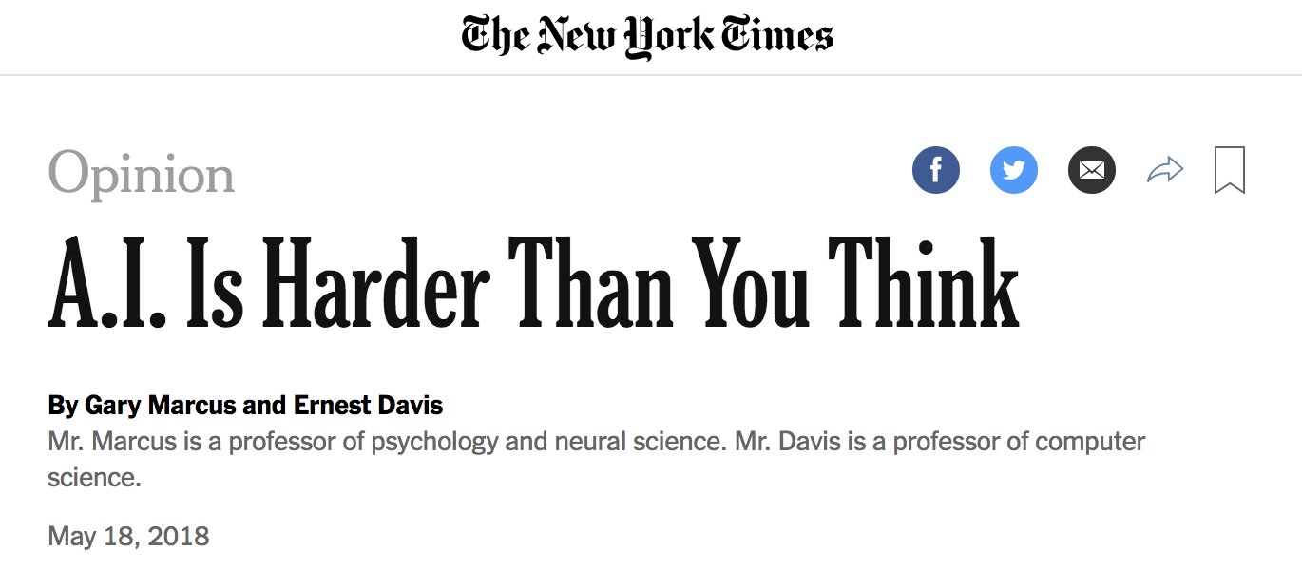
What AI can and cannot do
BUT...
Gary Marcus
Ernest Davis

Slide 30
What AI can and cannot do "A.I. is harder than you think"
Current AI is often isolated to single problems
Current AI is not superhuman in every task
AI models are not without bias
Fundamental differences in how AI perceive the world/environment

Slide 31
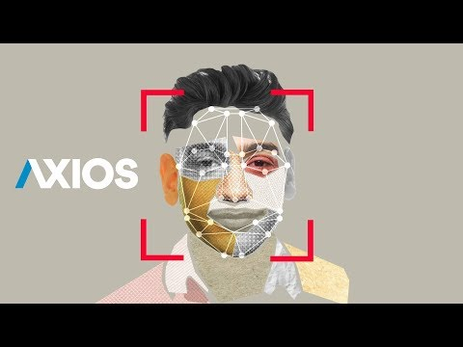
What AI can and cannot do AI can be biased
https://www.youtube.com/watch?v=NaWJhlDb6sE

Slide 32
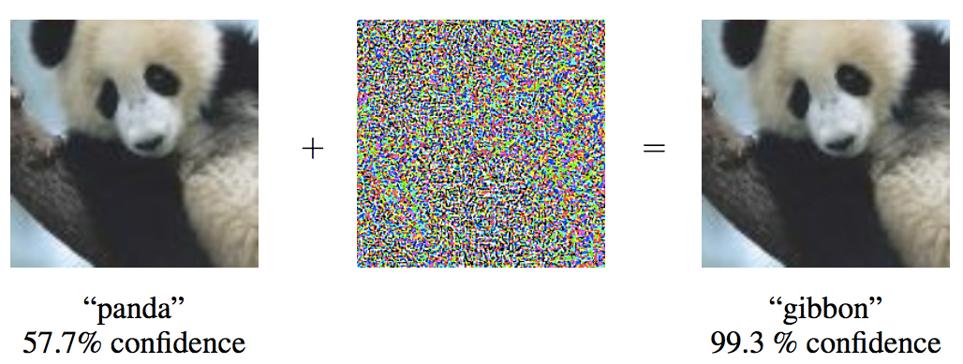
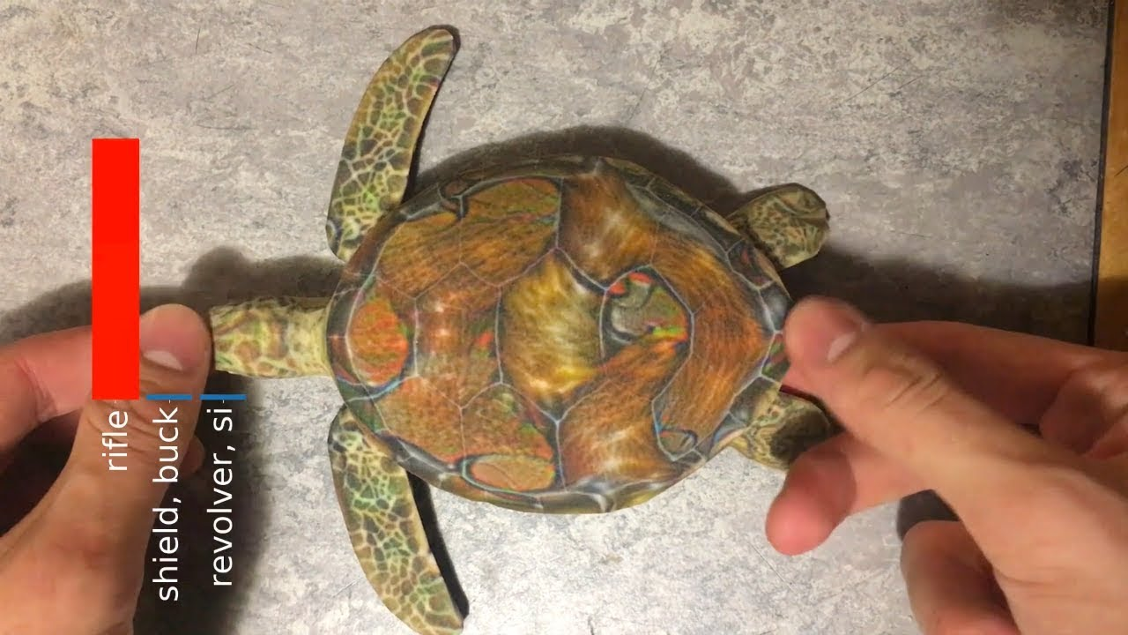
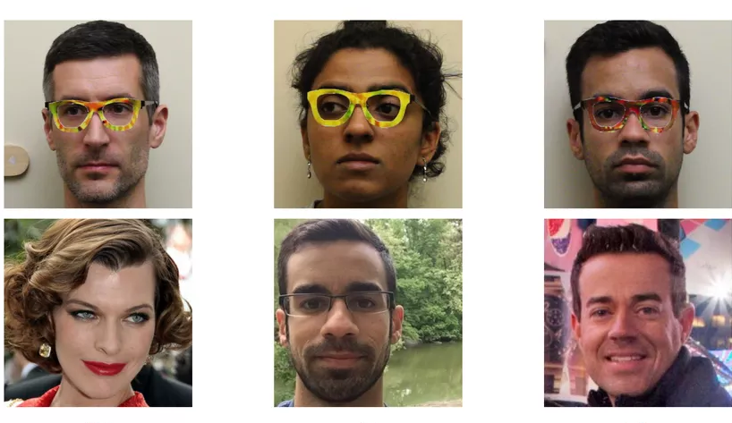
What AI can and cannot do AI can be tricked
https://www.youtube.com/watch?v=XaQu7kkQBPc

Slide 33
Summary
What is AI
What is Intelligence
Characteristics of AI
Potential of AI
You should be able to:
Explain what AI can be
Express some (philosophical) problems related to AI (Turing Test, Chinese Room, Bias,…)
Next Week: AI Systems

Slide 34
AI101
Organizational

Slide 35



Who we are
Lecture Prof. Kristian Kersting, Dr. Martin Mundt Artificial Intelligence and Machine Learning Lab (AIML)
Exercise Jannis Blüml, Johannes Czech
Timeslot Wednesdays at 16:15 in S2|02 C205 Lecture Wednesdays at 18:05 in S2|02 C205 Exercise (directly after the lecture)
Material and Questions (Forum) Can be found in Moodle (https://moodle.informatik.tu-darmstadt.de/)

Slide 36
Outline of this course
What is AI Week 1-2
Search Week 3 - 5
Knowledge, Reasoning and Planning Week 6 - 9
Introduction into (Machine) Learning and Neural Networks Week 10 - 11
Implications of AI, Summary and Outlook Week 12

Slide 37
Outline of this course Per Week
What is AI
AI Systems
Search
Problem-solving, (un)informed search
Local search, Adversarial search
Constraint Satisfaction Problems
Knowledge, Reasoning and Planning
Logic
First Order Logic (Logic 2)
Uncertainty and Bayes
Planning with STRIPS
Introduction into (Machine) Learning and Neural Networks
Intro into ML
ML Algorithms
So what is AI?
Implications of AI, Summary and Outlook
Aktuell 12 Lectures (von 13 Slots)

Slide 38
Exercise and Exam
Exercise
Weekly exercises
Weekly presentation of solutions and Q&A
Will be held in German
No correction
Not relevant for bonus
Relevant for the exam
Bonus
More information in the first exercise
Group project over the semester
Will be held in German
"Present" a topic of the lecture
Exam
Date: ...
90min written exam
Exam is in German

Slide 39
Recommended Literature
Russel and Norvig, Artificial Intelligence: A Modern Approach
Douglas R. Hofstadter, Gödel, Escher, Bach
Basic Book, New York 1979, Classic, inspiring, readable, original intro into AI
Kersting, Lambert, Rothkopf: Wie Maschinen lernen: Künstliche Intelligenz verständlich erklärt
Springer, 2019, Good book to learn the basics
Aurélien Géron, Hands-on Machine Learning with Scikit-Learn, Keras, and TensorFlow
O’Reilly, 2nd Edition 2019, Good book to start programming neural networks
Prentice Hall, 4th Edition 2020
Recommended text book to follow the lecture

